Slide 1
Internet of Robotic Things: Current Technologies, Applications, Challenges and Future Directions
Davide Villa
Matthew Heim
Liangshe Li
Xinchao Song

Slide 2
Outline
Introduction
Internet of Robotic Things
IoRT Architecture
Application Domains
Technology Challenges
Future Vision
Conclusion

Slide 3
Introduction: IoT and Robotics
Half slide for IoT (Gartner graph), half for Robotics (image + a few words)

Slide 4
Internet of Robotic Things
Combining the two for IoRT, with a couple of words/image for a high-level overview.

Slide 5
IoRT Architecture
Here we can insert the image dividing into the 3 layers and a few words.

Slide 6
IoRT Protocol Stack
Here we can put the big Table I and give an overview and a few words about the main protocol used and for what.

Slide 7
Other Key Elements
If needed, here we can have a separate slides in order to mention the role of the Cloud Computing and the Machine Learning (always putting a few images for the visual representation).

Slide 8
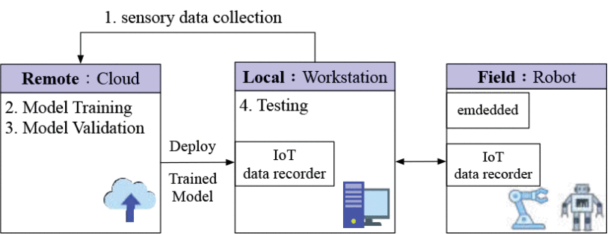
Application Domain: Disaster Response
IoRT has been widely used in many fields. Disaster response in paper [21] is one of best examples to show how robots and IoT integrate.
Disaster response mainly has four steps:
Collect sensory data from environment and transmit it to cloud
Build AI model using data collected by robots
Evaluate the AI model
The AI model is deployed to local workstation for further testing and continuing learning process
[21] M. F. R. Lee and T. W. Chien, “Artificial intelligence and internet of things for robotic disaster response,” in 2020 International Conference on Advanced Robotics and Intelligent Systems (ARIS), August 2020.

Slide 9
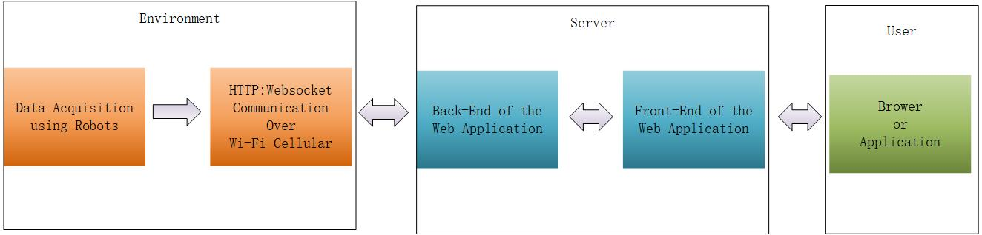
Application Domain: Precision Agriculture
Another application is precision agriculture in paper [22].
Precision agriculture mainly has three steps:
1. Collect environmental data using robots and deploy data to server over Wi-Fi cellular
2. Server process the data received and deploy the visualized data to users.
3. Laptop and mobile represents the user interface.
[22] H. Durmus¸ and E. Gunes, “Integration of the mobile robot and internet of things to collect data from the agricultural fields,” in 8th International Conference on Agro-Geoinformatics, pp. 1–5, July 2019.

Slide 10
Technology Challenges
Here we can mention the challenges in the use of the IoRT comprising: Data processing, Security and Safety. We could make a pointed list with a few words and some figure at the right if needed.

Slide 11
Ethical Issues
Mention here the issues here and regulations. We have already the images from Xinchao in the paper.

Slide 12
Future Vision
Put the nice picture used in the paper and a few words for smart cities and smart manufacturing.

Slide 13
Conclusion
Wrap up what we have presented with a pointed list and highlighting the motivation of this paper which is the awareness and research principles.
a

Slide 14
Thank you

Slide 15
References
Put again a list of references

